Slide 1

Awesome chocolate sales data report
Created by
ASFANA AZEEZ

Slide 2
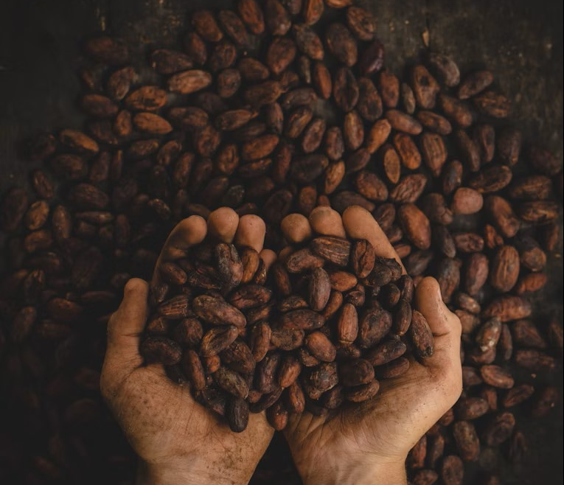




AGENDA
Introduction
Tool used
Questions and query
Conclusion

Slide 3


INTRODUCTION
Chocolate sales data provides valuable insights into consumer preferences and market trends within the confectionery industry.
Analyzing sales figures, distribution channels, and product preferences allows business to understand market dynamics and identify growth opportunities.

Slide 4

Tool used
MySQL Workbench 8.0E

Slide 5

QUESTIONS AND QUERy

Slide 6
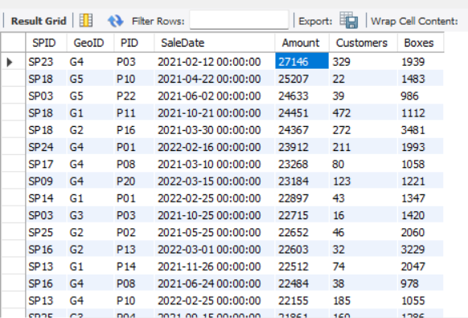

Industry Outlook
1. Calculate the Amount greater than 10,000 in decreasing order from the data ?
The query identifies the amount greater than 10,000 from the sales data.

Slide 7
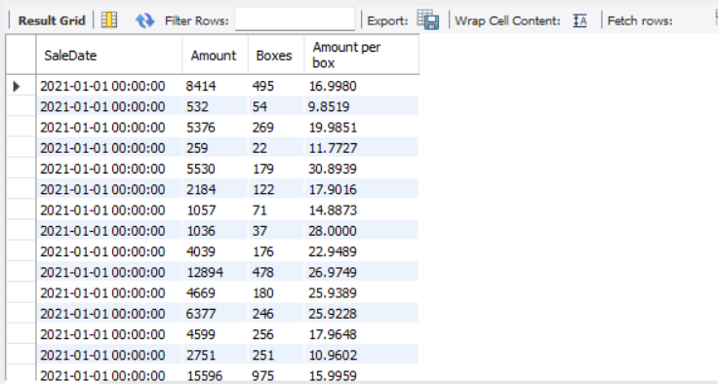
2. What is the amount per box of chocolates from the sales report ?
The query calculates the amount per box of chocolates from the report.

Slide 8


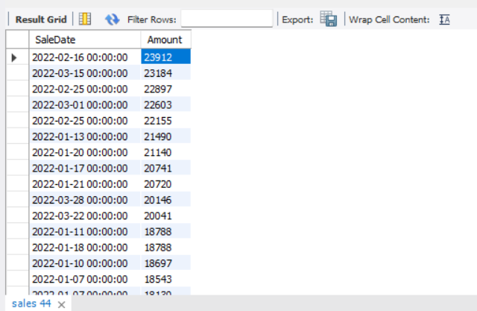
3. List the amount greater than 10,000 in the year 2022 by decreasing order ?
The query identifies the amount greater than 10,000 in 2022 by decreasing order.

Slide 9

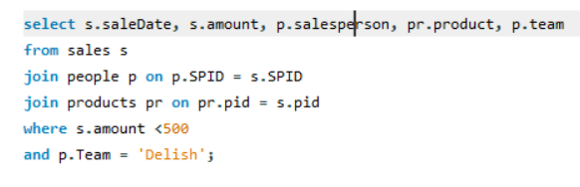
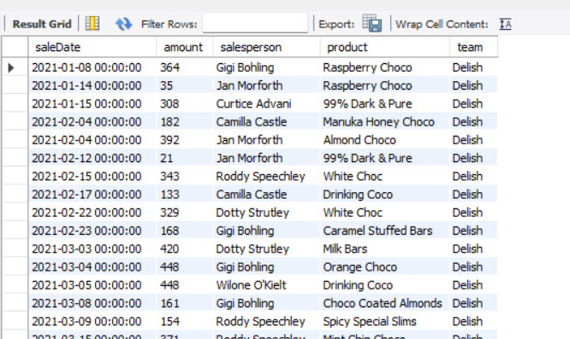
4. Join the date of sales, salesperson product of amount less than 500 from the team ‘Delish’ ?
This query join the date of sales, salesperson and the product of amount less than 500 from team ‘Delish’.

Slide 10

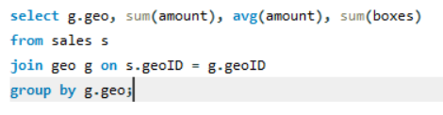
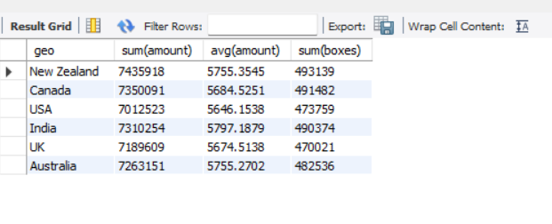
5. Calculate the sum and average of the amount and the sum of boxes from different geographical area ?
The query calculates the sum and average of amount and sum of boxes based on the geographical area.

Slide 11

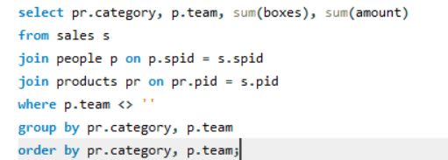
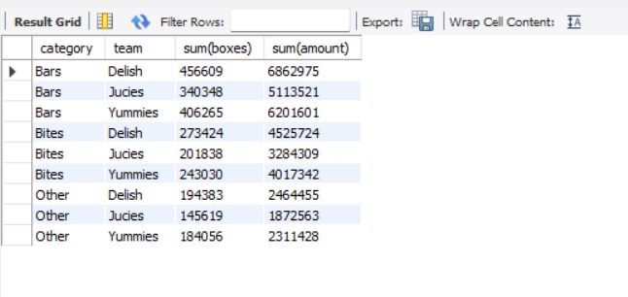
6. What is the total amount coming from team and a category ?
This query calculates the total amount coming from a team and category by sorted.

Slide 12


Conclusion
This chocolate sales report based on SQL queries would summarize key findings, highlighting trends, top-selling products, and customer segments.
For example, it might conclude that a specific product category or region drives the most sales, or that a particular customer segment exhibits strong purchasing power.

Slide 13
THANKYOU!
ASFANA AZEEZ
asfanaazeez@gmail.com

